Slide 1
Springboard Capstone 3 Abdul Hannan 10/2022
Sentiment Analysis

Slide 2
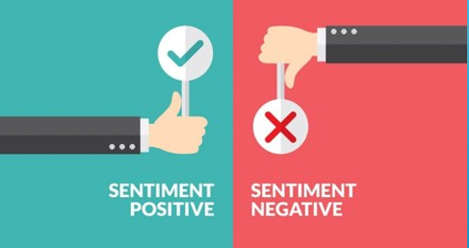
Introduction
It is important to gauge customer response.
Aim to assist customers better.
A lot of variables were generic and were not used in modeling.
Unbalanced classes.

Slide 3
Data Wrangling
17 columns in which 13 are generic (repetitive in nature), and only 3 will be used to create a model.
515,738 entries with no missing data in the interested columns (Positive Review, Negative Review, Reviewer Score).
Almost 400k+ reviews came from a Leisure trip and the rest were from business trip.
we have 1492 hotels, in 6 countries total, with United Kingdom has the most with 262301.

Slide 4
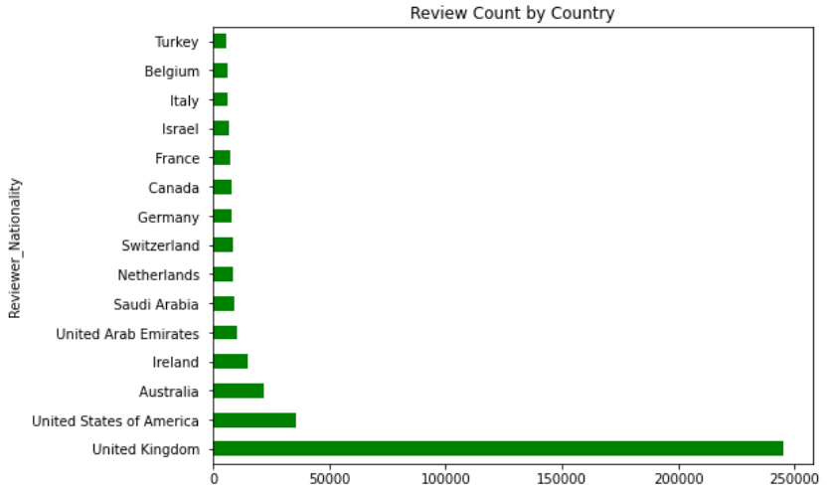
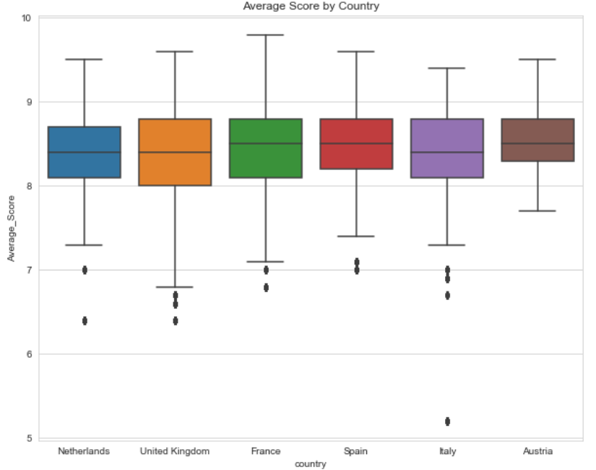
Exploratory Data Analysis
Almost 375k+ reviews came from reviewer with a score 8 or more, meaning that we have a lot of credible reviewers.
People whose first language is English tend to give higher ratings than people who do not.
We have 1492 hotels from 6 countries with France and United Kingdom having 400+ hotels.
We see reviewer score go up from October – January, the time of festivities and travel.

Slide 5
Pre-Processing and Training
After selecting the three columns, we began to clean our textual data.
If the score is 7.5 and up it is considered positive, otherwise negative.
From our EDA, we learned that a lot of the reviews had a score of 8 and up, hence our target class is negative here for this problem.
The steps we used to clean our textual data are:
Lowering the text.
Removing Punctuation.
Removing Stop words.
Lemmatizing the text.
The logistic regression model from the LogisticRegression class corroborated that resampling is needed. One class did significantly better than the other.

Slide 6
Modeling
Two vectorizers were used – CountVectorizer & TfidfVectorizer.
Two resampling methods were used - Random Under Sampler & SMOTE.
Naïve Bayes, XGBoost, Random Forest.
In total we have 10 models (not 12) because tree boosted models were more time consuming and less effective.
Naive Bayes with TF-IDF Vectorization is the best model we have out of all, as it gives us the recall of 0.85.

Slide 7
Conclusion
Successfully created a model to predict the sentiment given textual data.
Data is collected from six countries with France having the most hotels (438), people with English as their first language tend to have higher scores than people who do not.
To outline the business problem, the metric we used to compare our models is recall, as we wanted to avoid the possibility of false negatives.
Naïve Bayes with term frequency – inverse document frequency vectorization produced the highest recall ensuring us to avoid an external cost to a hotel’s reputation due to our model.

Slide 8
Future Work
Data augmentation to reproduce data which in turn might lead to better accuracy for our models.
Keyword Extraction will help us find meaningful insights in a short span of time and help us identify the topic / or problems customers have based on their reviews.
Text Summarization can help us create new phrases and sentences that captures the most useful information, as this technique involves paraphrasing without having to read word to word.

Slide 9
Thank you!

